Slide 1
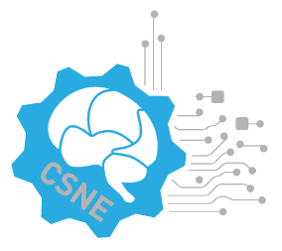

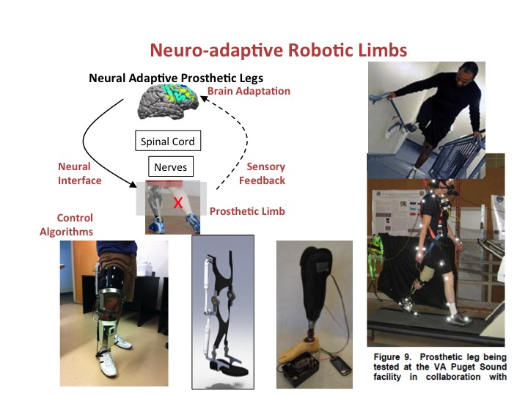
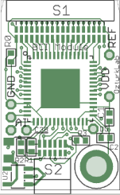
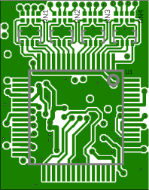
Center for Sensorimotor Neural Engineering
Component Based Testbed Design
Sens/Act
Wearable BCI
External Device
ECoG
Multi-Ch.
ZigBee
Comm.
Module
EMG
VCSEL
Comm.
Module
EEG
Analog Process Module
A/D
DSP Module
BlueTooth
Comm.
Module
Control Module
Wireless I/F
BioSignal I/F
BioData I/F
DSP
Module
Haptic Feedback
Functional Stimulator
Feature Extraction
Passive Motion Machine
Prediction
Orthosis
Prosthetic Devices
Physiological Sensor Components

Slide 2
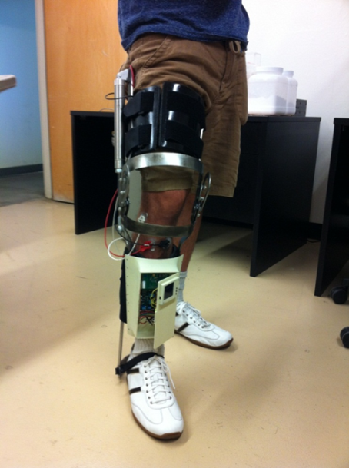
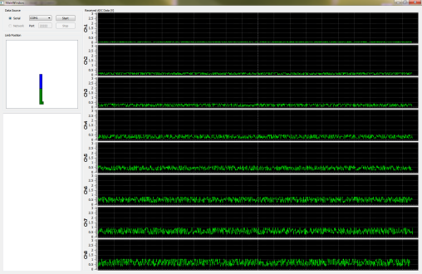

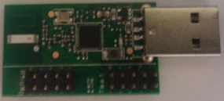
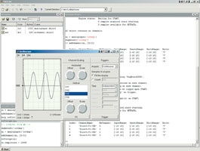
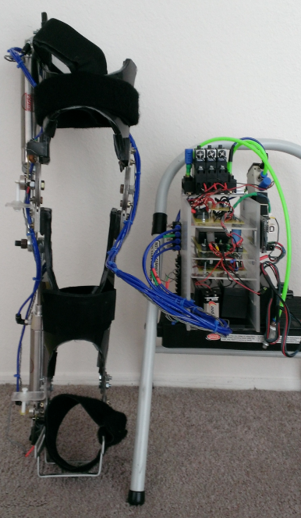
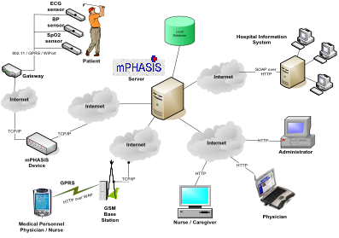
Opportunities for testbed integration A closed loop walking gait rehabilitation
Center for Sensorimotor Neural Engineering
Radio
Wearable device
Muscle activity
Limb position
Real time
Wireless
Prototype 2 with Control Systems
Notes:
Lower Extremity at Sdsu and UW
Auto-adaptive algorithms and learning. - -
Signal Extraction to decode user intent
Highlight first and last example on next 2 slides

Slide 3
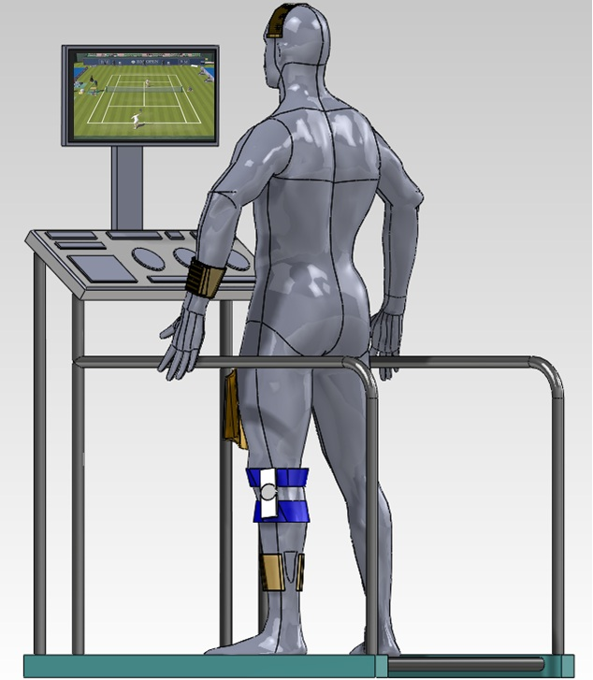
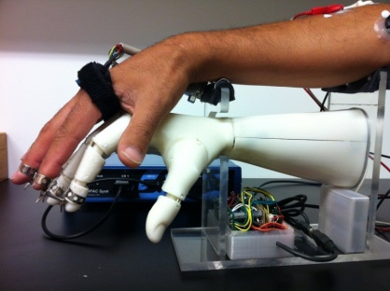
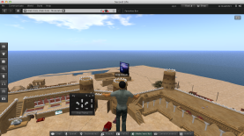
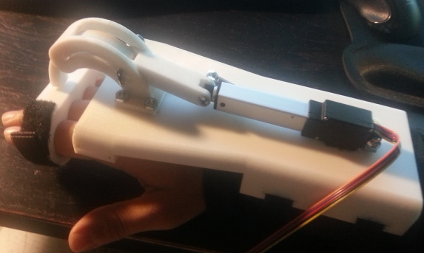
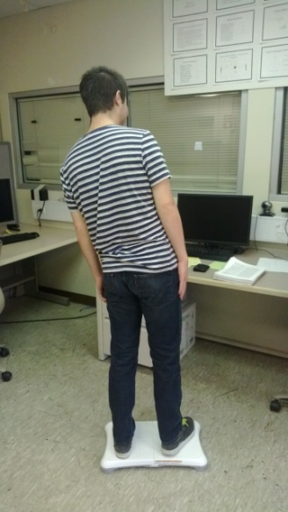
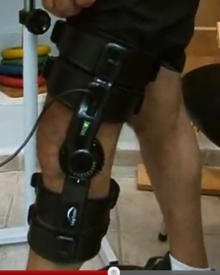

Home/Game Based Rehabilitation
Center for Sensorimotor Neural Engineering
Moving gets you around
Traditional keyboard input replaced with physical activity
Walking
Arm/hand motion
A Simple Marble Maze game for balance assessment and rehabilitation
Off the shelf (cheap) hardware for home rehabilitation
Ozturk (PI), Moon (SDSU)
Notes:
Yusuf Ozturk and Kee Moon at SDSU are using mobility of the patient to drive a game. Their knee rehabilitation device uses a new sensor developed driving a game based rehabilitation solution. Their first application is to use of secondlife and rather than using the keyboard , use actual mobility of the patient to move in secondlife (jumping or similar move can initiate flying etc).

